Slide 1
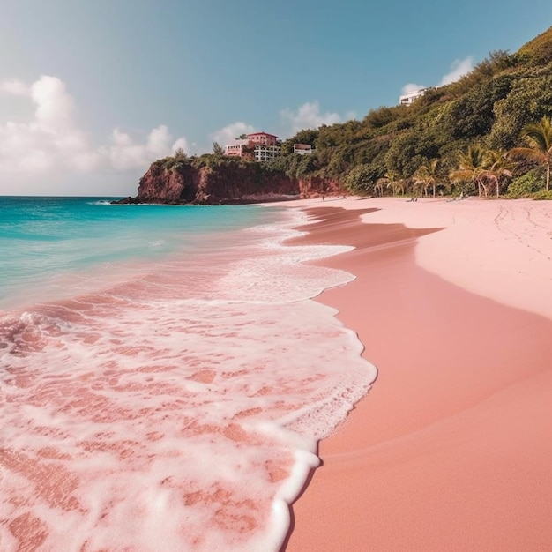
Weather in Bermuda Island
Justina Konopackaja | DE
Capstone project
Notes:
10 min
Atlantic Ocean/Pink sand beaches
Why this API
Methodology/Approach
Limitations/Challenges
Demo of dashboard
What are areas for improvement
Questions

Slide 2
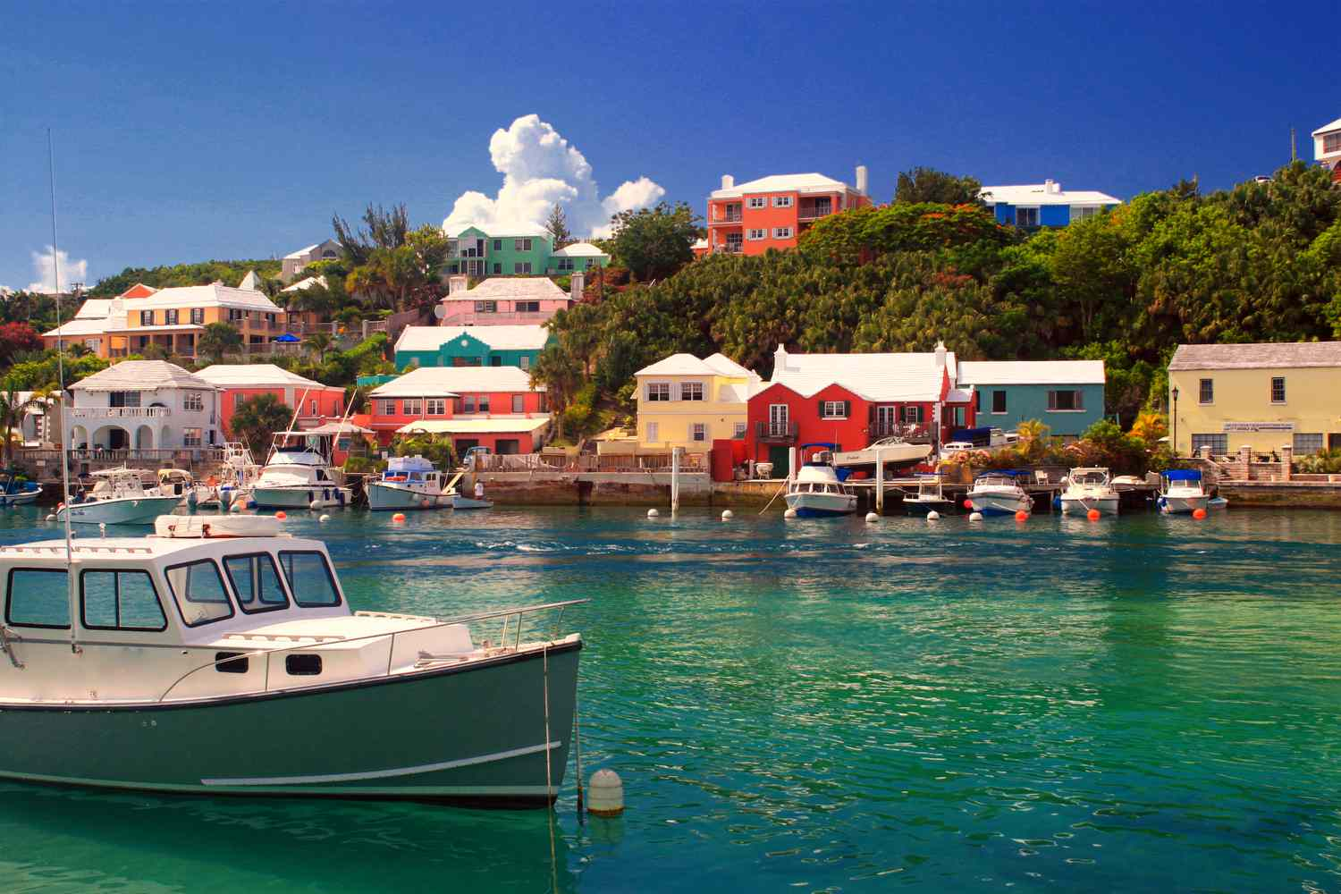
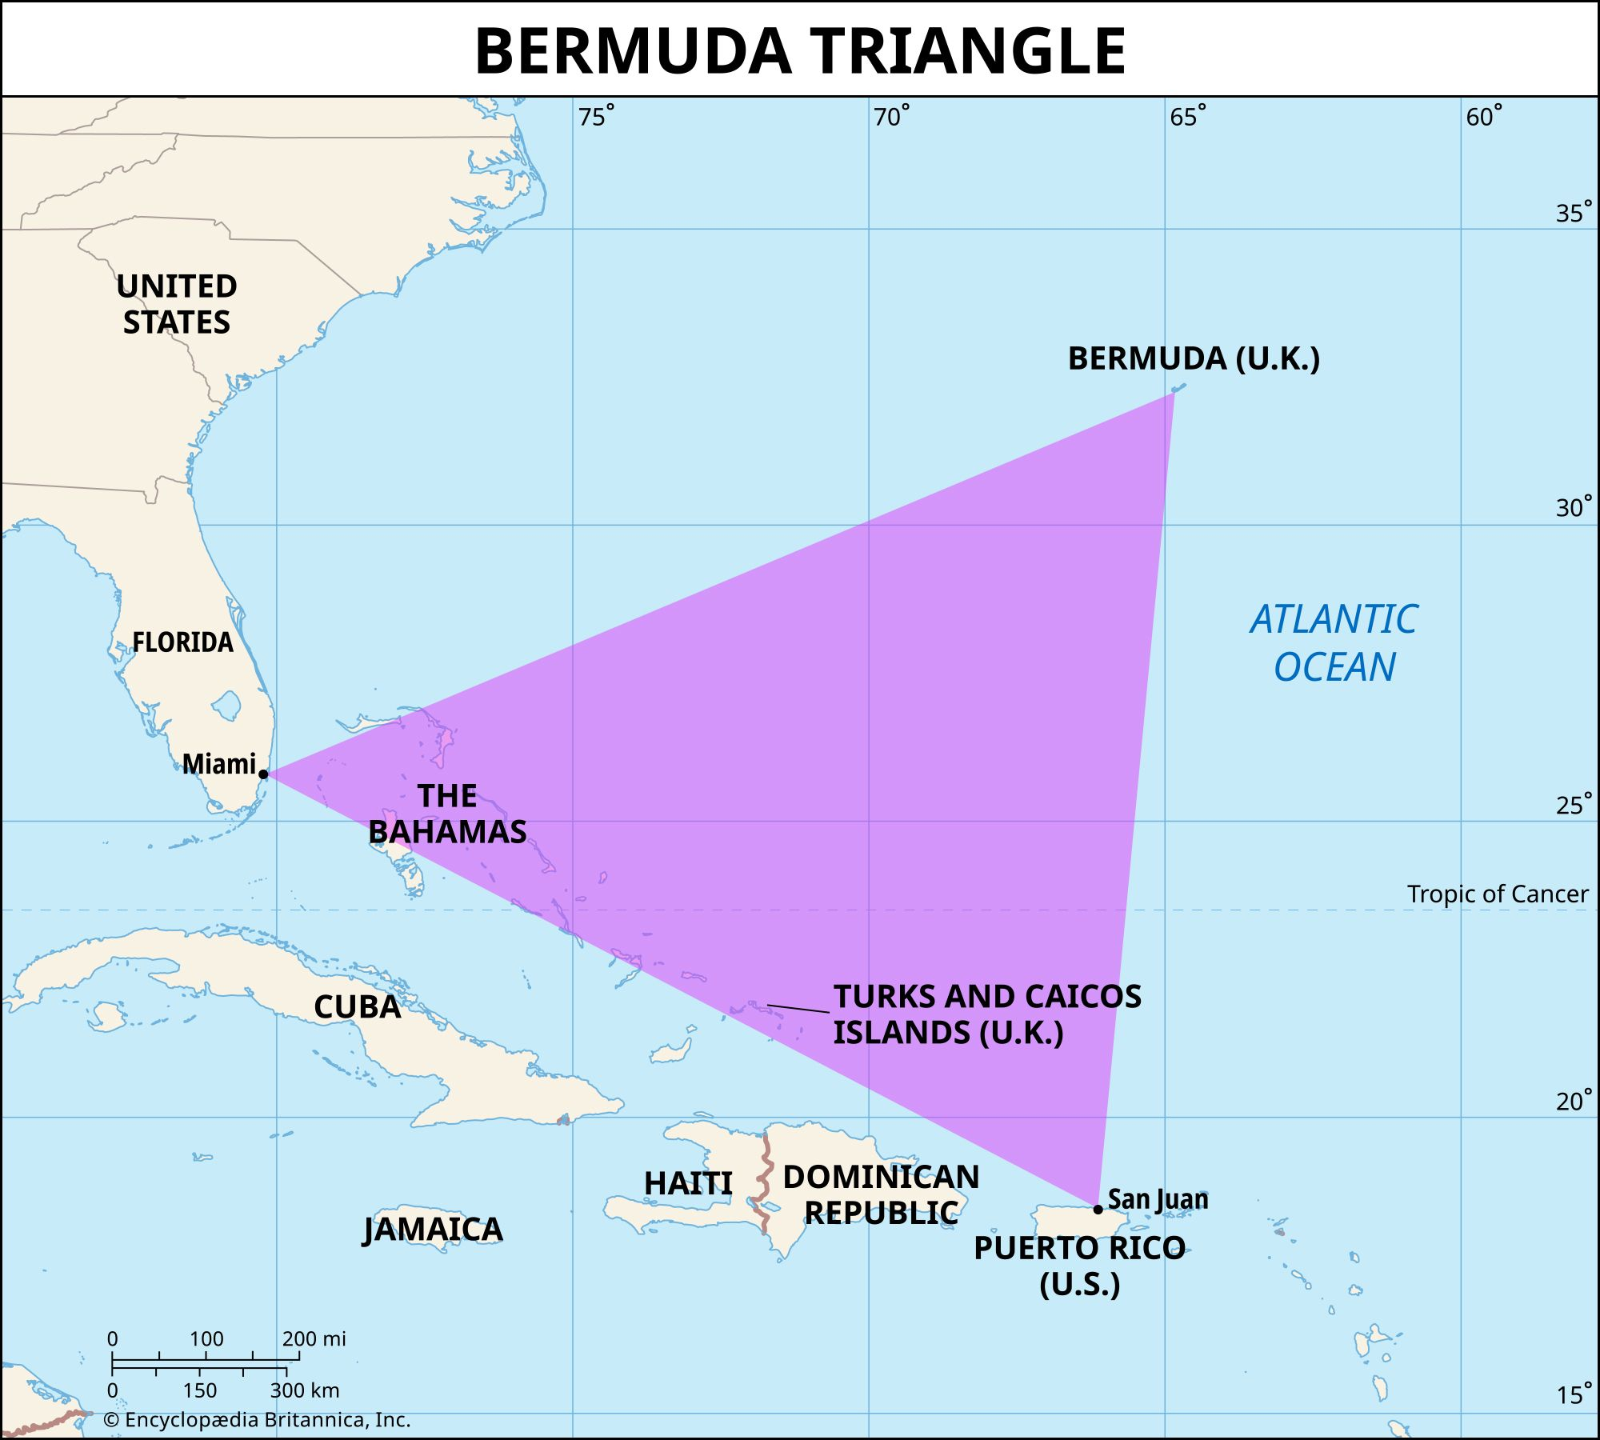

The exact number of ships and airplanes that have disappeared in the Bermuda Triangle is not known. The most common estimate is about 50 ships and 20 airplanes
Notes:
Vocation
Travelling
Mystery/Adventures
Ship graveyard

Slide 3
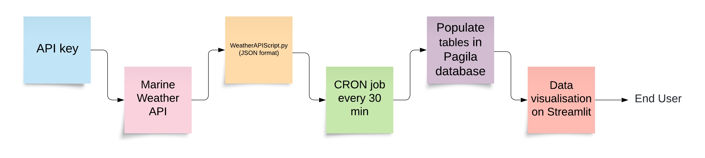
Methodology / Approach
Data collection automation (creating a pipeline)
CRON job (30min)
Pagila (current weather, forecast, tides)
Streamlit

Slide 4
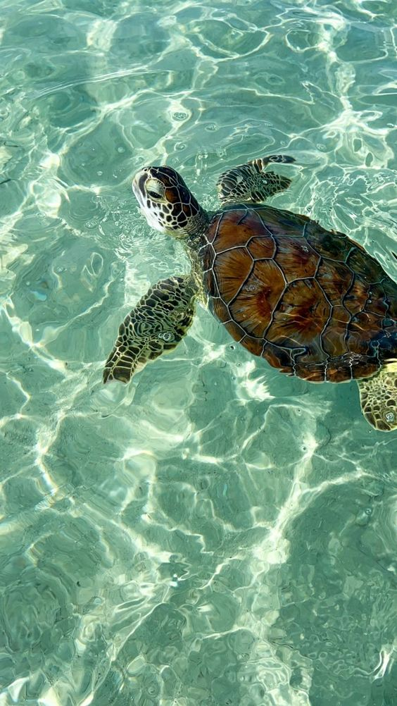
Limitations/Challenges
Free API (limited)
Time (more in demo)
Me (technical knowledge)

Slide 5

Demo
https://super-space-guacamole-pj74w7j4g69v279jq-8501.app.github.dev/

Slide 6

What can be improved
Make it more
More locations (Bermuda Triangle & World)
Historical weather data API, Seismographic data
Self-improvement
Better use of the data
Deadline
Stop worrying
No limits!
Lots of opportunities
More visualisation (correlations)
Astro | Tides

Slide 7

Thank you
Questions?

